Slide 1

Introduction to React.js
What is React, JSX, Overview and Syntax
SoftUni Team
Technical Trainers
Software University
https://softuni.bg

Slide 2

Table of Contents
React Overview
Installation
JSX Syntax
Composition

Slide 3
Have a Question?
sli.do #js-web

Slide 4

React Overview
History and Philosophy

Slide 5
What is React.js?
React is a JavaScript library for building user interfaces (UI)
Focused on creating reusable components
Developed by Facebook
const HelloMessage = (props) => (
<div>Hello {props.name}</div>
);
ReactDOM.render(
<HelloMessage name="Maria" />,
document.getElementById('root')
);

Slide 6
Features
Open-source
Declarative
Design simple views for each state in your app
Easier to debug
Component-Based
Encapsulated components that manage their own state
Keep state out of the DOM

Slide 7

Features
Isomorphic
JavaScript that runs on both client & server
Better user experience
Native support
Compose rich mobile UI in Android, iOS

Slide 8

Advantages
Easy to learn
Fast performance
Use all ES6 features
Promises, Classes and Modules
Compatible with other libraries
Great error reporting

Slide 9

React Installation
Packages, Setup, Structure

Slide 10
Create React App
Less to learn - instant reloads help you focus on development
Only one dependency - no complicated version mismatches
No Lock-In - under the hood Webpack, Babel, ESLint
Install the React app creator (one-time global install)

Slide 11
Install and Run the React App Creator
Run the React app creator
Starts your React app from the command line
Browse your app from http://localhost:3000
npx create-react-app my-app
cd my-app
npm start

Slide 12
Finding Information
Visit the official website
Documentation
Online sandbox
https://reactjs.org/
https://reactjs.org/docs/installation.html
https://codesandbox.io/

Slide 13
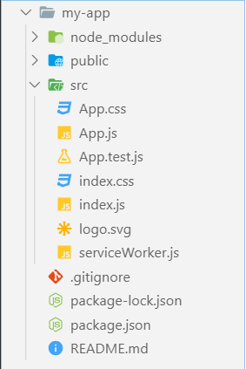
React App Structure
package.json - project configuration
Module name, dependencies, build actions
index.html
App main HTML file
index.js
App main JS file (startup script)
App.js, App.css, App.test.js
React component "App"

Slide 14

Live Demo

Slide 15

JSX Syntax
JSX
Overview, Syntax, Advantages

Slide 16
JSX Overview
JSX is React's JavaScript superset language
Has all of JavaScript's features and more
Unique approach to mixing HTML and JS
Compiles to plain JavaScript
<div className="red">Children Text</div>
React.createElement("div",
{ className: "red" },
"Children Text"
);

Slide 17
JSX Syntax
<div className="red">Children Text</div>
<MyCounter count={3 + 5} />
Expression
let gameScores = {
player1: 2,
player2: 5
};
<DashboardUnit index="2" onClick={() => {}>
<h1>Scores</h1>
<Scoreboard className="results" scores={gameScores} />
</DashboardUnit>
Custom component
Pass variable as prop

Slide 18
JSX Rules and Principles
Standard elements use lowercase names
div, span, form, input, …
Custom components always use Pascal case
MyCustomComponent, Greeting, ScoreBoard, …
Component name cannot be an expression
Use a variable instead
There must be a root element
More info at: https://reactjs.org/docs/jsx-in-depth.html

Slide 19
Compilation
JSX compiles to function calls
<div className="red">Children Text</div>
Element type (HTML tag name)
Properties object
React.createElement("div",
{ className: "red" },
"Children Text" [, …]);
List of children

Slide 20
Live Demo

Slide 21

Composition
Definition and Advantages

Slide 22
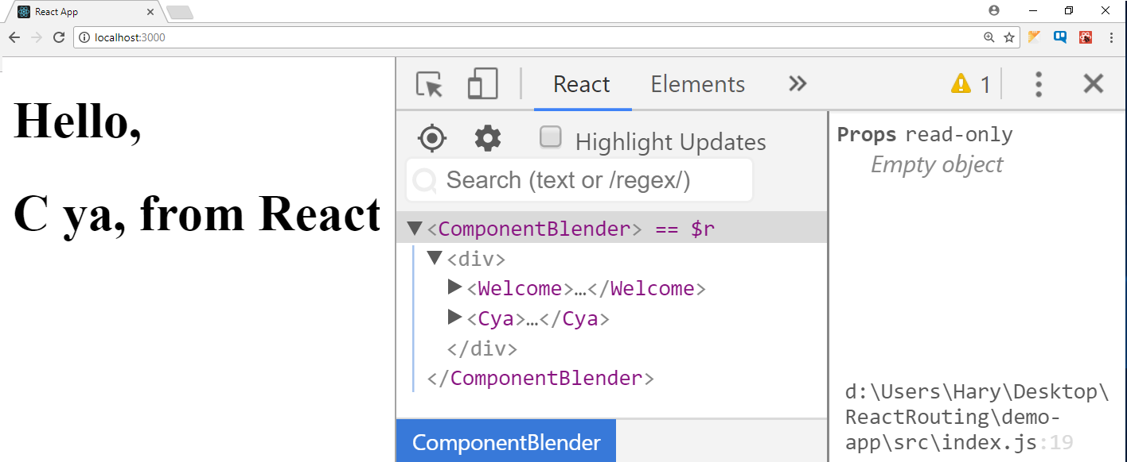
Composition
React components can be nested, like DOM elements
function Welcome() {
return <h1>Hello, from React</h1>;
}
function Cya() {
return <h1>C ya, from React</h1>;
}
function ComponentBlender() {
return (
<div>
<Welcome />
<Cya />
</div>
);
}
ReactDOM.render(<ComponentBlender />,
document.getElementById('root'));

Slide 23
Component Syntax
Names always start with uppercase
Tags must be closed
If there are no children - use self-closing tags
Information is passed via props
<Dropdown> A dropdown list <UserHead name='homeHeader' />
<Menu>
<MenuItem>Do Something</MenuItem>
<MenuItem>Do Something Fun!</MenuItem>
<MenuItem>Do Something Else</MenuItem>
</Menu>
</Dropdown>

Slide 24
Advantages
Encapsulate logic
Separate your code
Easier to maintain and debug
Allows reusability
Components are neat

Slide 25
Live Demo

Slide 26

Summary
React is a JavaScript library for building user interfaces
React uses all ES6 features
JSX is React's JavaScript superset
React components can be nested (composition)

Slide 27
Questions?
Notes:
27

Slide 28












SoftUni Diamond Partners

Slide 29


Educational Partners

Slide 30
Trainings @ Software University (SoftUni)
Software University – High-Quality Education, Profession and Job for Software Developers
softuni.bg, about.softuni.bg
Software University Foundation
softuni.foundation
Software University @ Facebook
facebook.com/SoftwareUniversity
Software University Forums
forum.softuni.bg
30
Notes:
30

Slide 31

License
This course (slides, examples, demos, exercises, homework, documents, videos and other assets) is copyrighted content
Unauthorized copy, reproduction or use is illegal
© SoftUni – https://about.softuni.bg
© Software University – https://softuni.bg
Notes:
31

